Slide 1
Gone Fishin’
Jon Genty (2849), George Hodgkins (4755), Nathan Keyes (5198), Fazal Mahmood (1127), Nick Treviño (2389)
Notes:
Jon

Slide 2
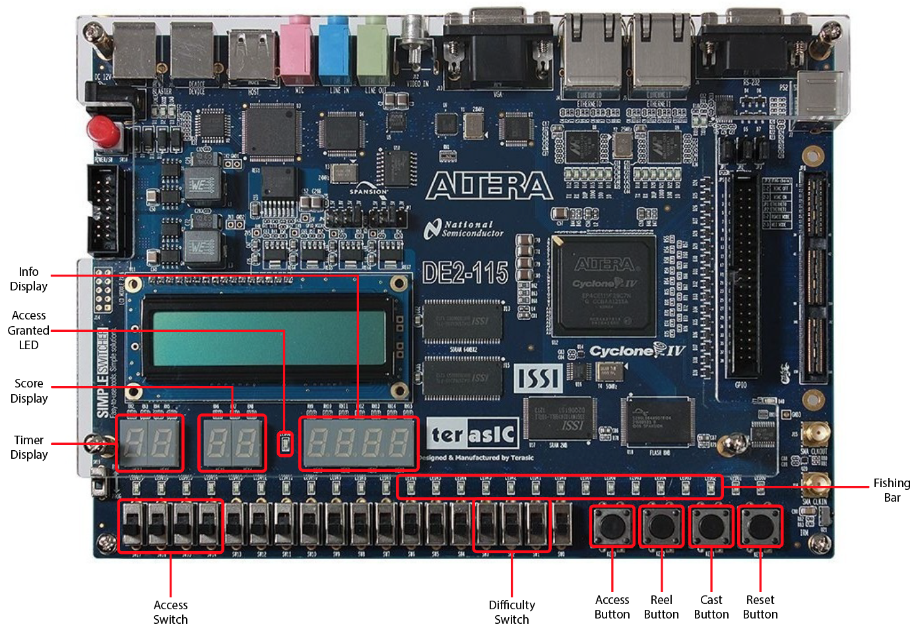
Board Layout
Notes:
Jon

Slide 3
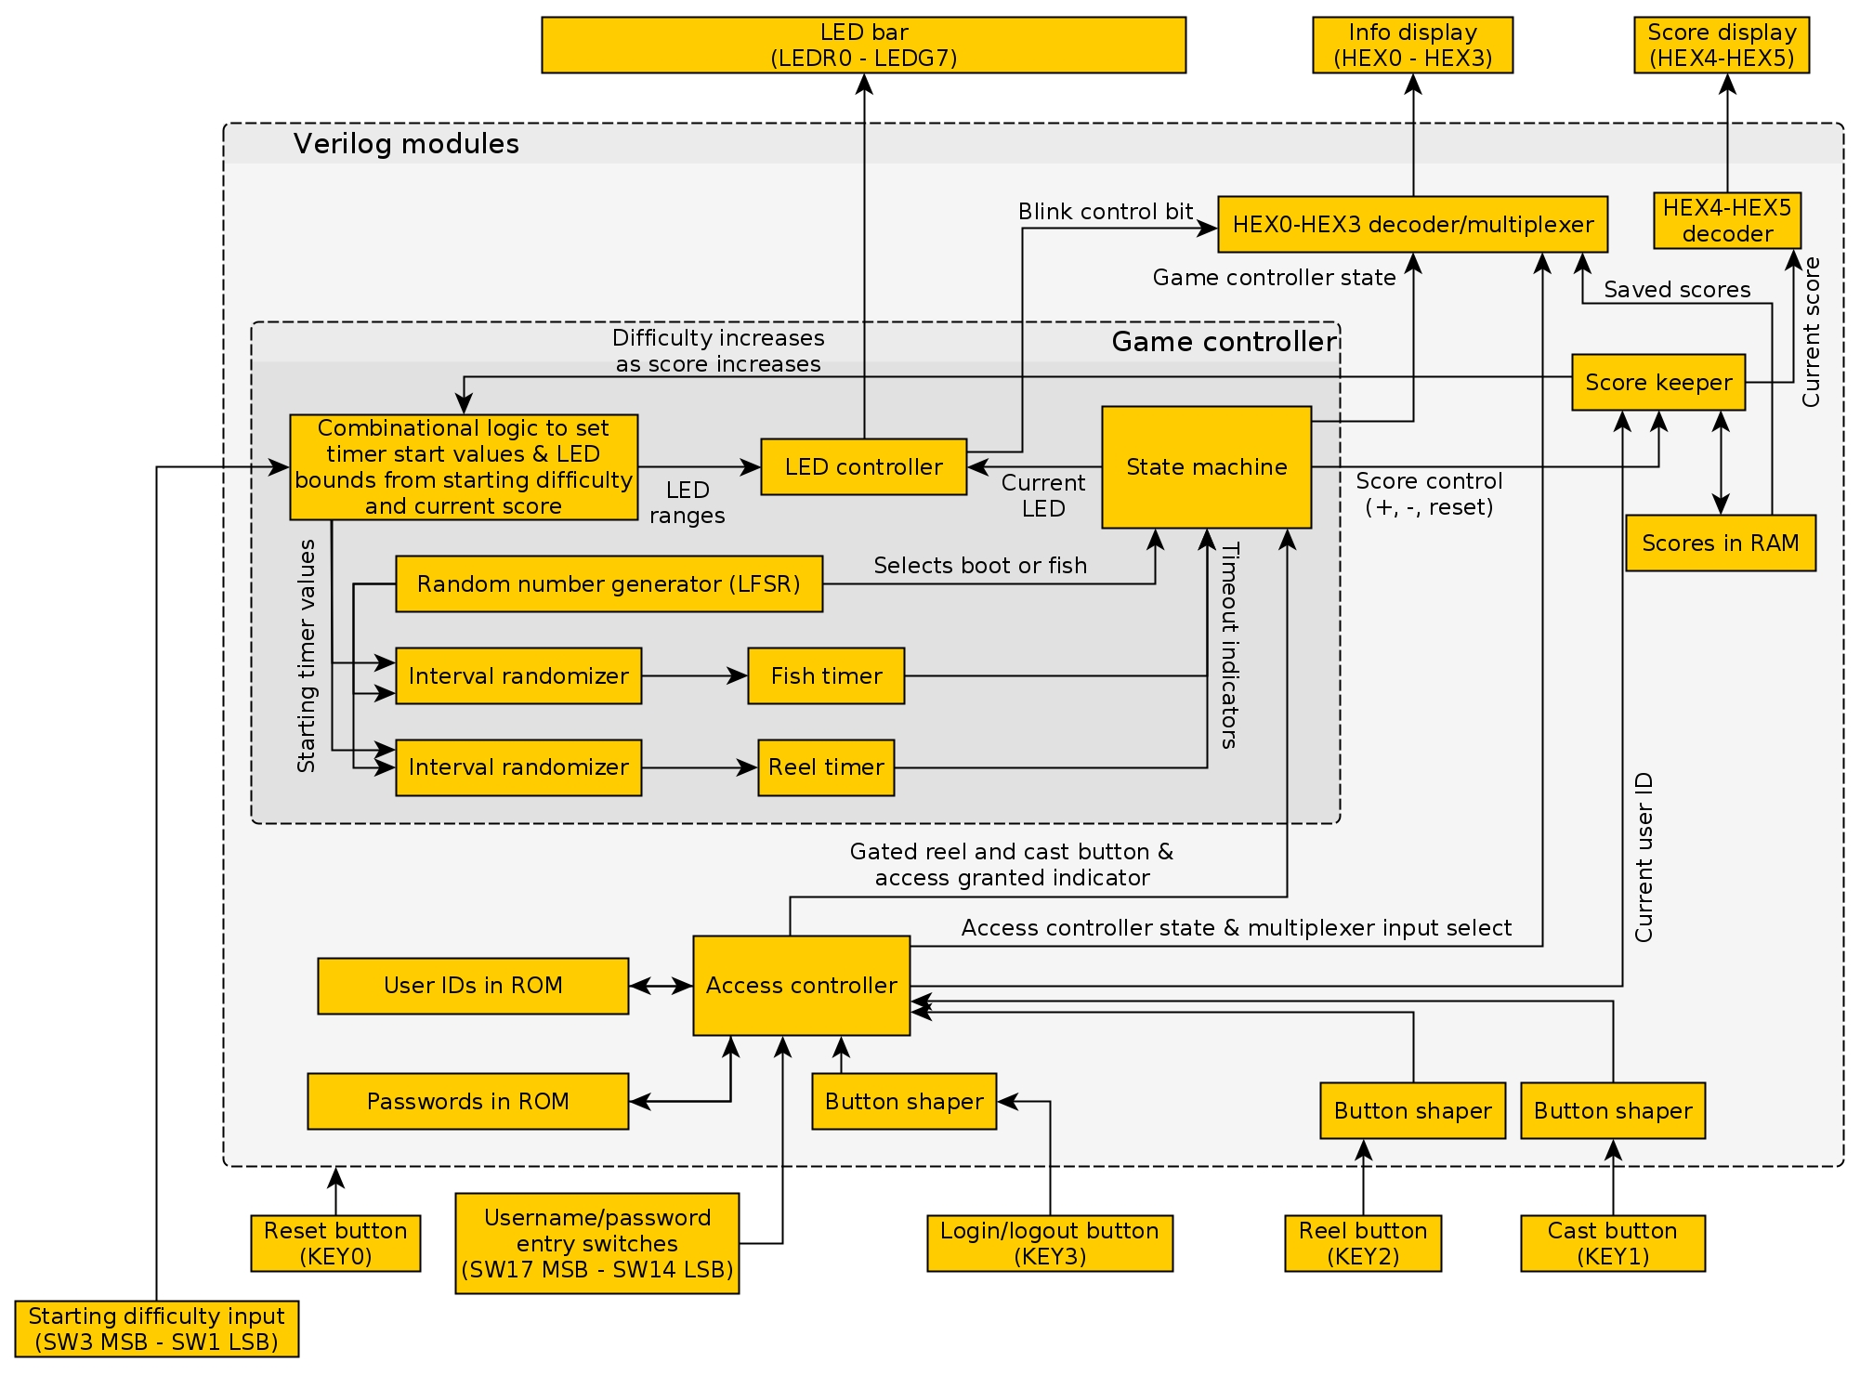
System Architecture
Notes:
Nathan

Slide 4
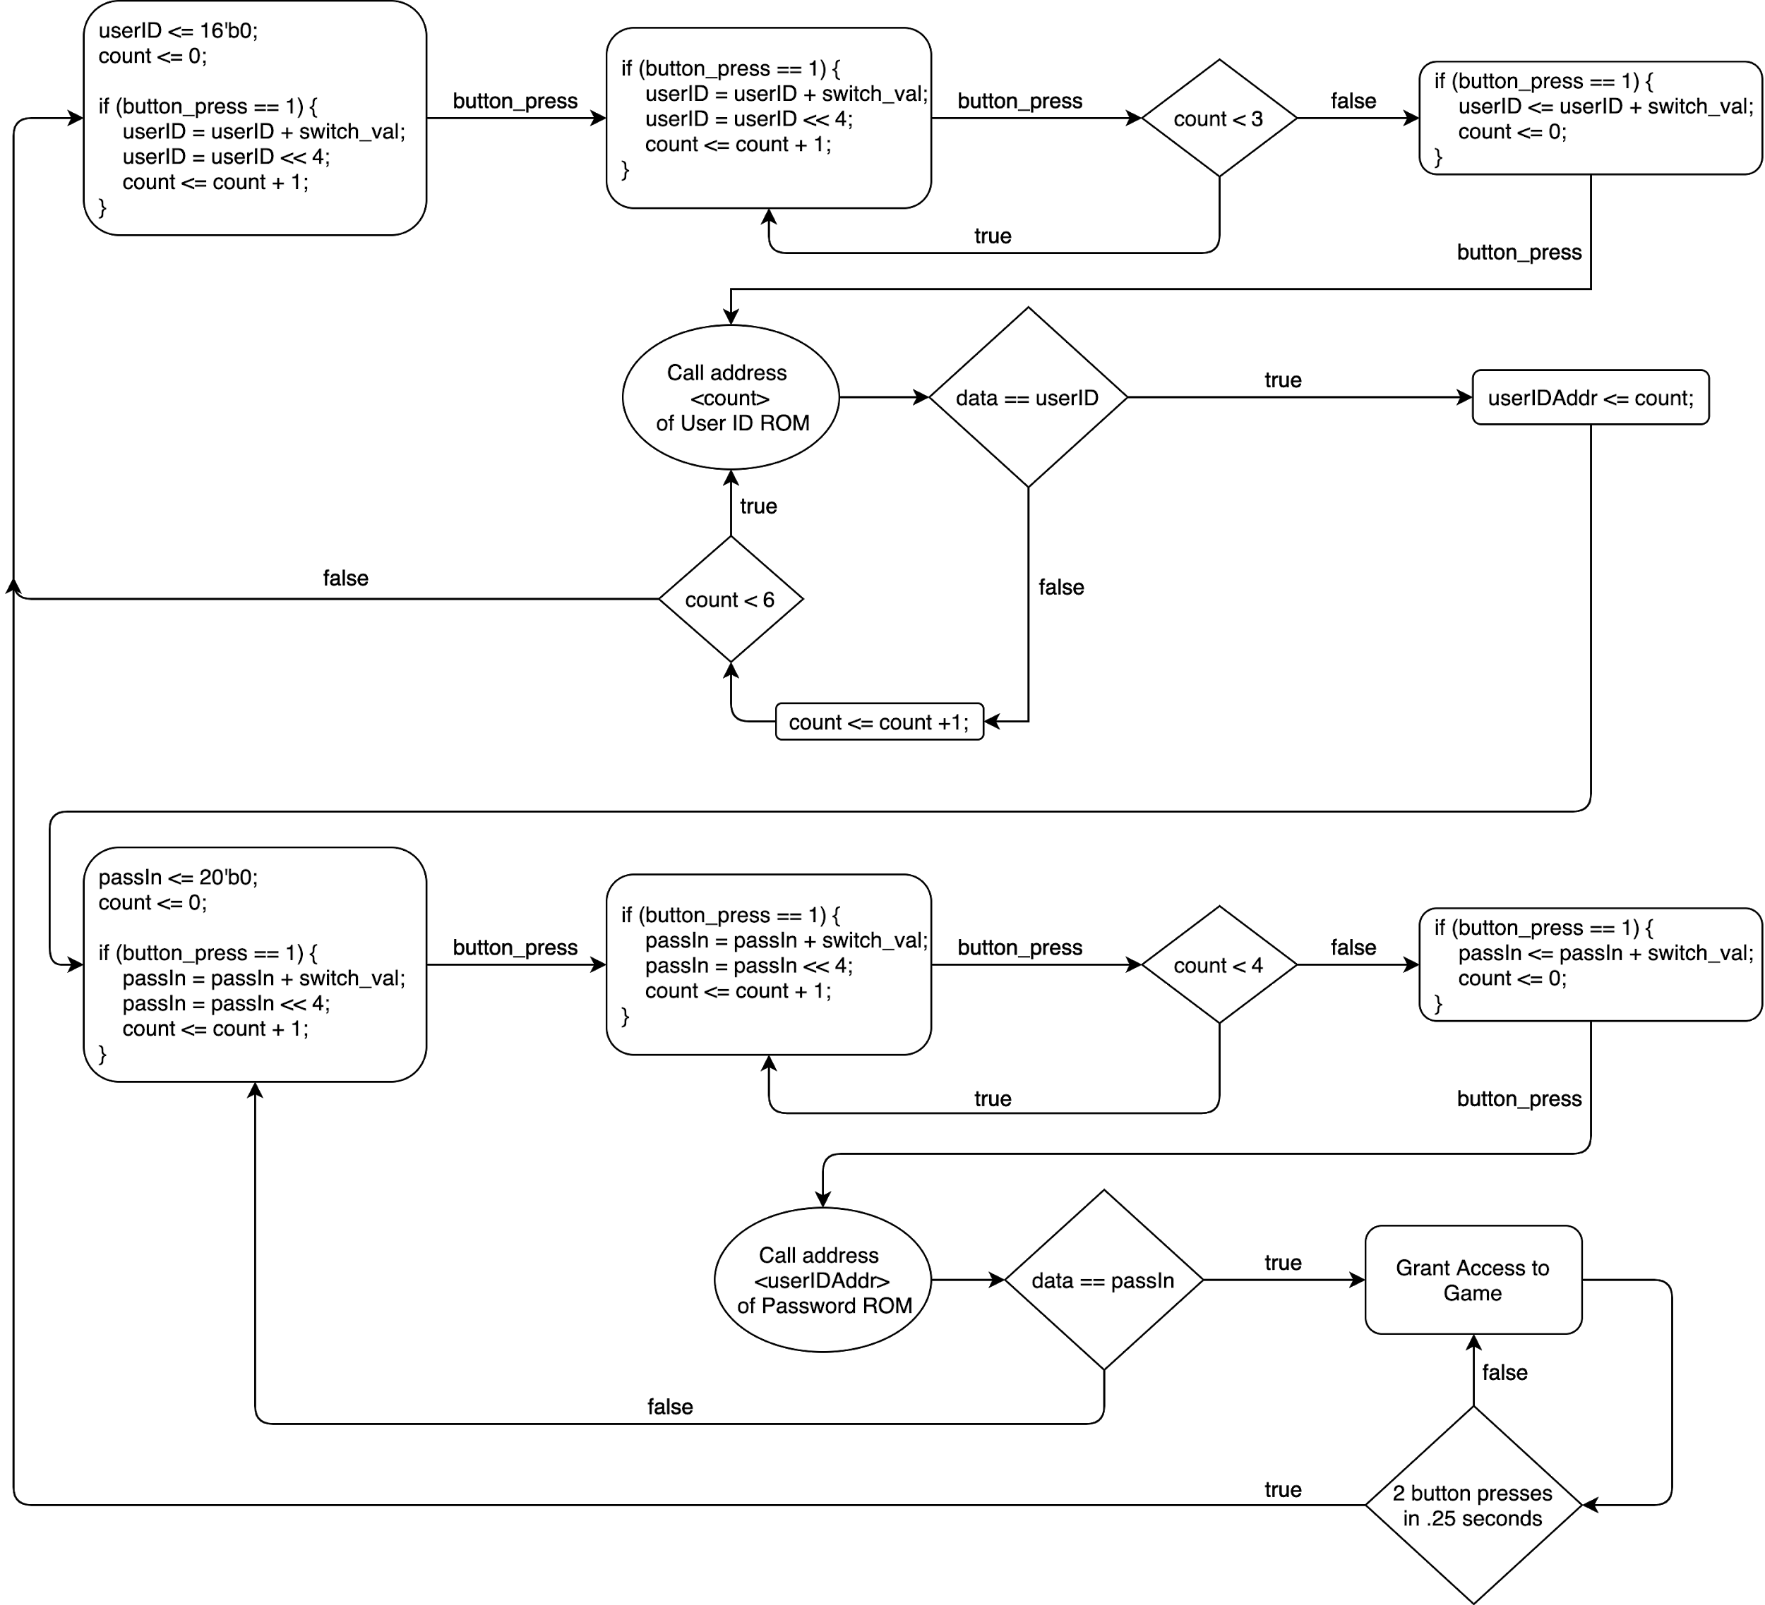
Access Controller Flow Chart
Notes:
Fazal
To authenticate the user, we built the access controller module
This offers Multi-User Login of 6 unique Accounts, including a guest (User Id is 4 chars and Passwords are 5 chars)
A User can logout by double clicking the access button at any point.
This module has 3 Major stages (Gather inputted User ID, Compare to each ROM address, Gather Password Input)
If input matches ROM, then user inputs password.
As long as the password matches the same address as the user ID but in the Password ROM, then user is granted access
If password is incorrect, re-entrying the user ID will not be necessary
There are an unlimited number of attempts.

Slide 5
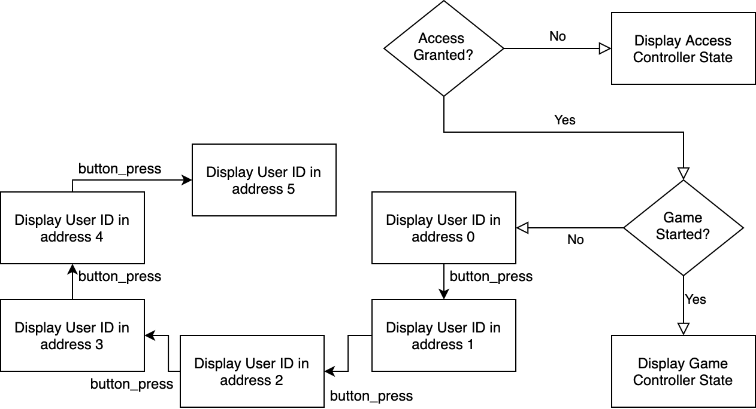
Display Decoder Hex 0 - Hex 3 Flow Chart
Notes:
Fazal
The purpose of adding this module is to create a better UX by providing a “Info Display”
This has three major stages
When access is not granted, this module will display the States of the access controller such as which char of the user ID or Password it is currently waiting on to be loaded
When access is granted but game has not started, this module will use the access_button as a trigger to round robin all user IDs in ROM continuously and a separate decoder will display the respective User ID’s high score
And finally, when access is granted and the game has started this will display Game Controller states such as “FISH” and “BOOT”

Slide 6

Display Decoder Hex 4 - Hex 5 Flow Chart
Notes:
Fazal
The purpose of adding this module is to create a better UX by providing a “Info Display”
This has three major stages
When access is not granted, this module will display two dashes
When access is granted but game has not started, this module will use the access_button as a trigger to round robin all user high scores in RAM
And finally, when access is granted and the game has started this will display the score of the current game being played

Slide 7
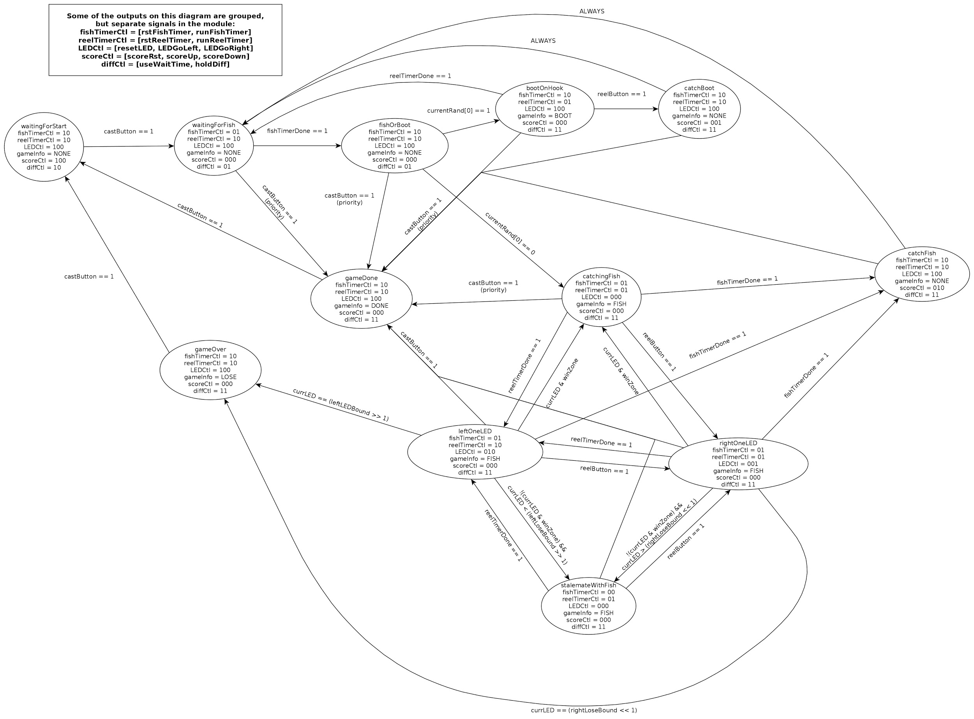
Gameplay
Diagram
Notes:
George

Slide 8
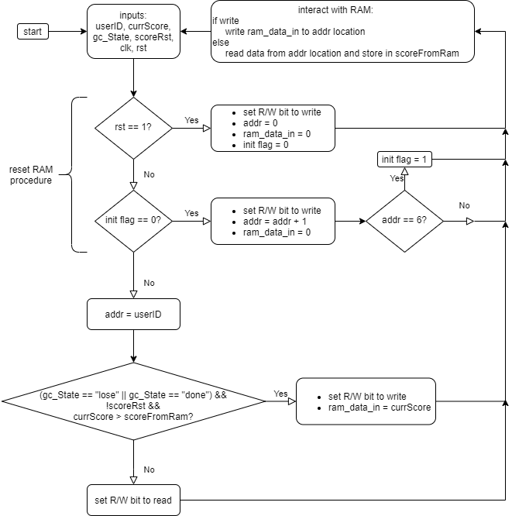
Score Save
Flow Chart
Notes:
Nick

Slide 9
Gameplay Demonstration
Notes:
Jon-we’ll now show a demonstration of our gameplay

